Slide 1

Tonks
Door:
Edin Halilovic
Walid el Hasnaoui
Tjitse Venema
Alex Koppendraier

Slide 2
Inhoud
Casus
Ontwikkeling
Product

Slide 3
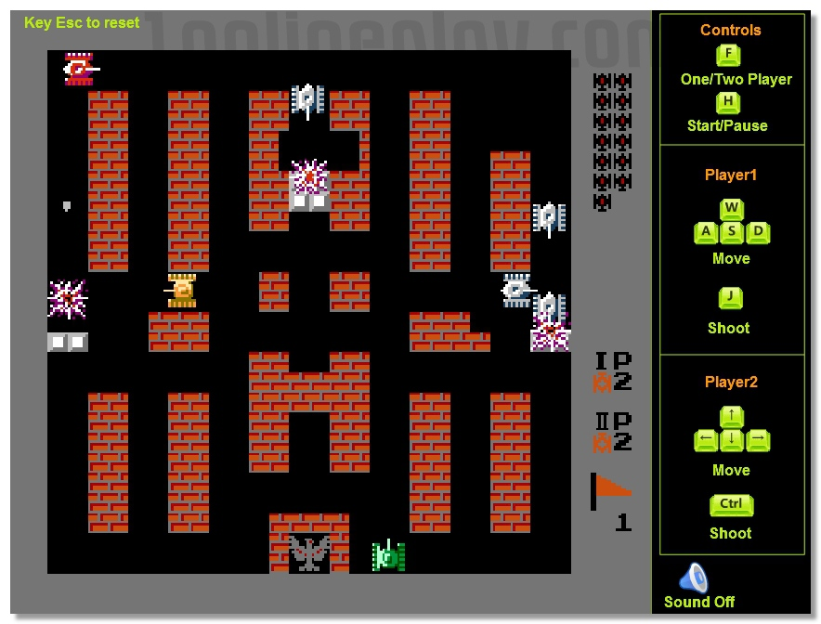
Casus
https://nl.wikipedia.org/wiki/Battle_City

Slide 4

Ontwikkeling
https://unity3d.com/

Slide 5
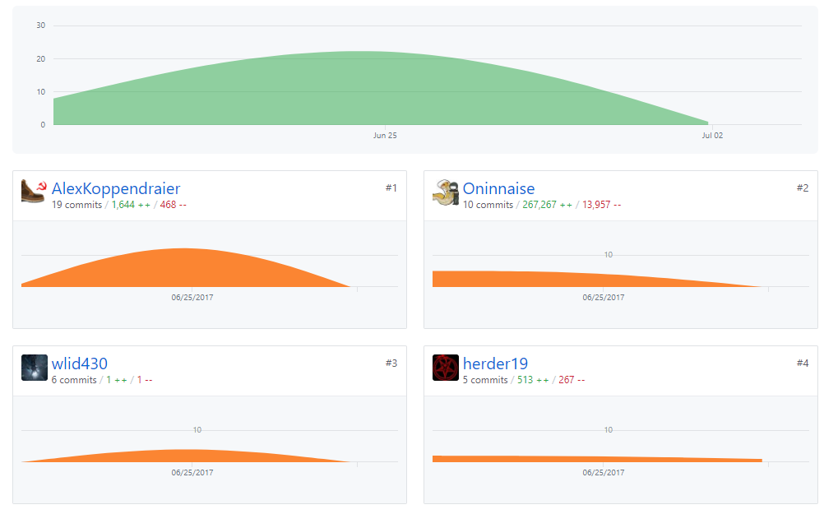
Ontwikkeling
https://github.com/Oninnaise/Groep4tanks/graphs/contributors

Slide 6

prototype
https://github.com/Oninnaise/Groep4tanks

Slide 7

code
https://www.visualstudio.com/vs/visual-studio-express/

Slide 8
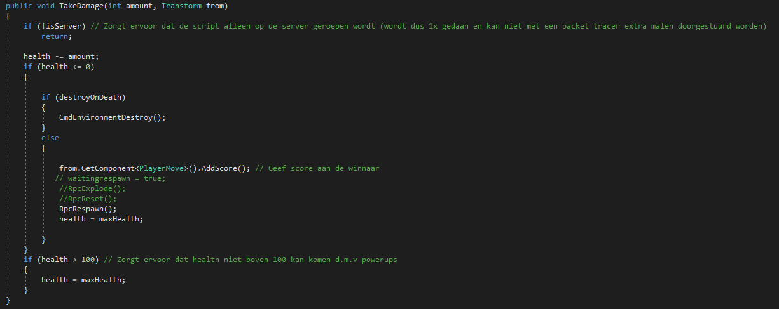
code
https://github.com/Oninnaise/Groep4tanks/blob/master/Assets/Scripts/Player/Combat.cs

Slide 9
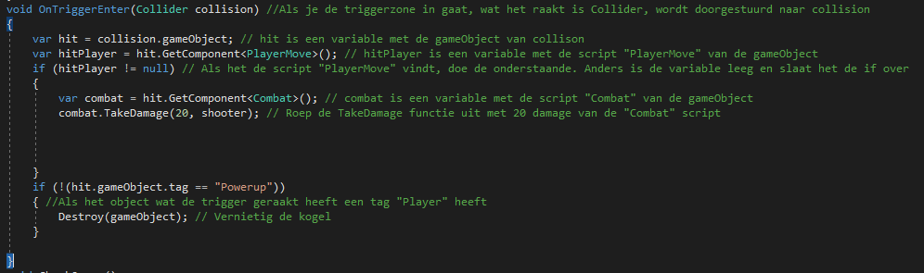
code
https://github.com/Oninnaise/Groep4tanks/blob/master/Assets/Scripts/Guns/Bullet.cs

Slide 10
code
https://github.com/Oninnaise/Groep4tanks/blob/master/Assets/Scripts/Guns/Bullet.cs

Slide 11
code
https://github.com/Oninnaise/Groep4tanks/blob/master/Assets/Scripts/Guns/Bullet.cs

Slide 12

Vragen

